Slide 1
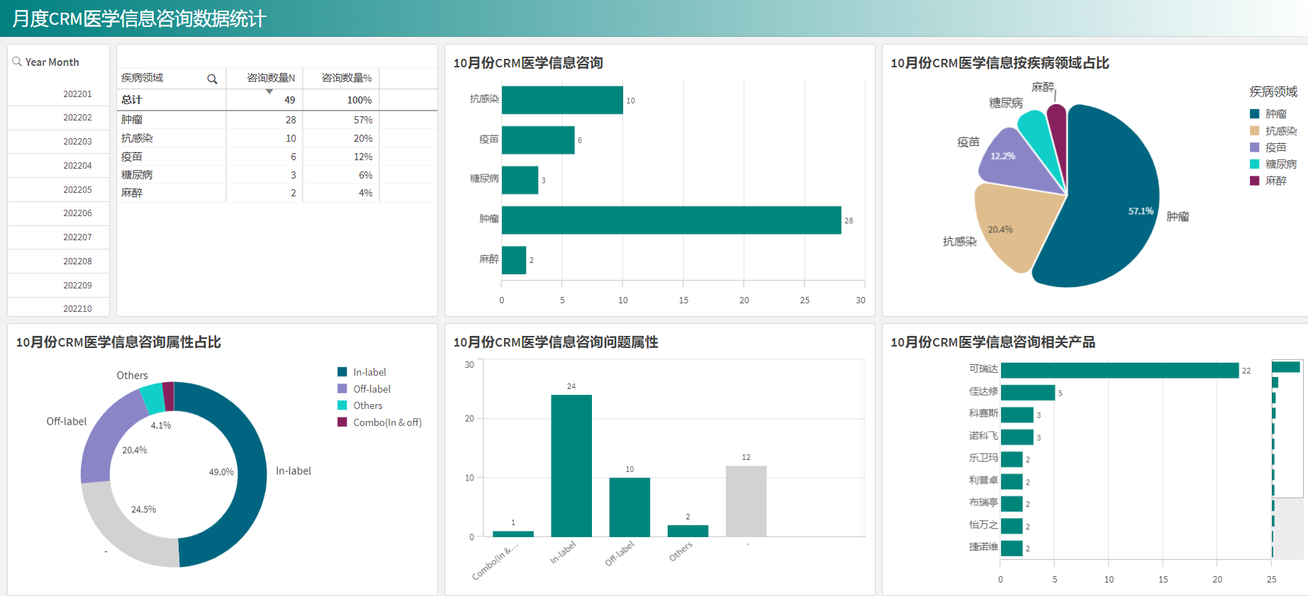
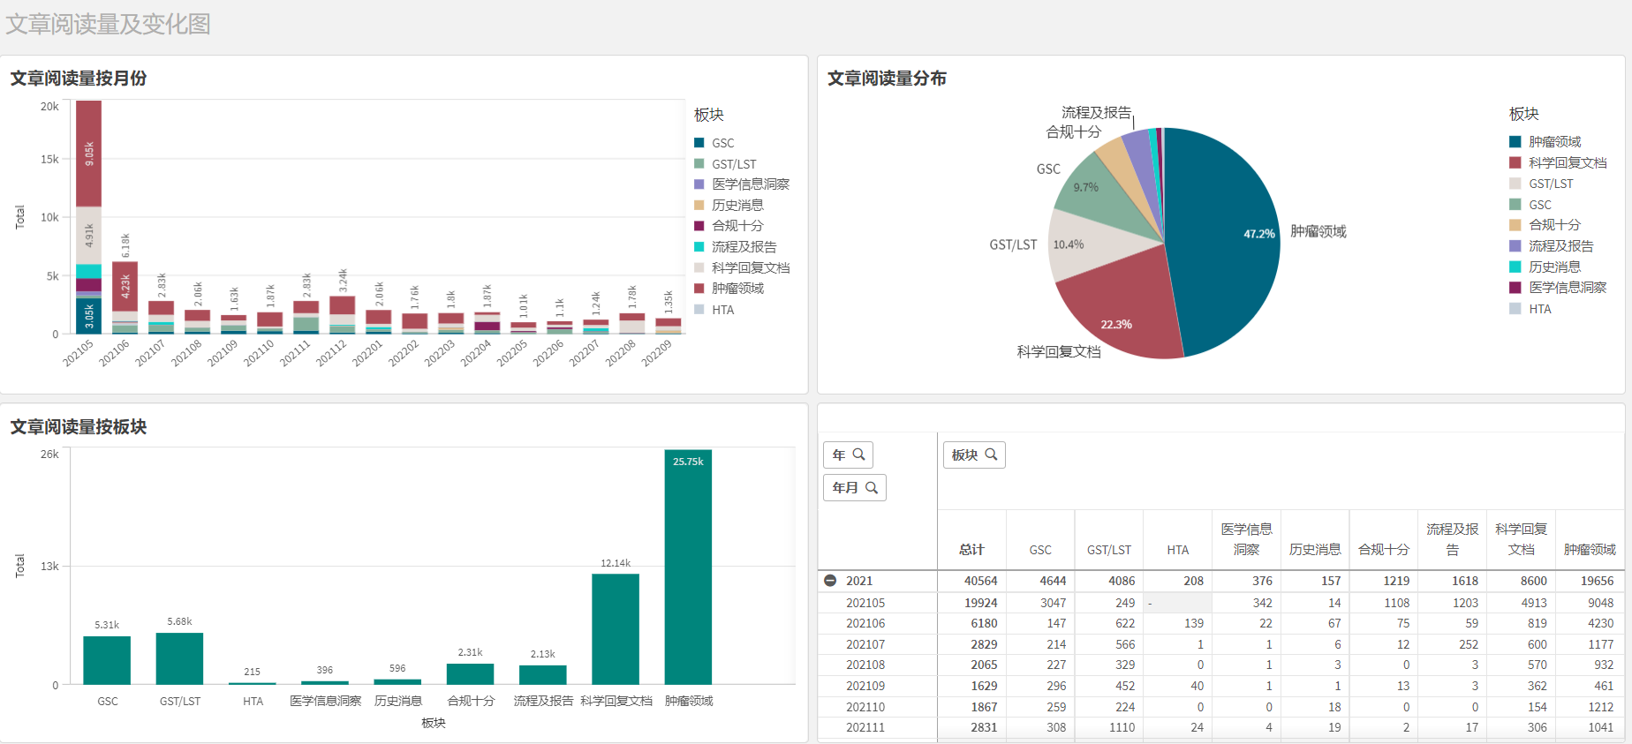
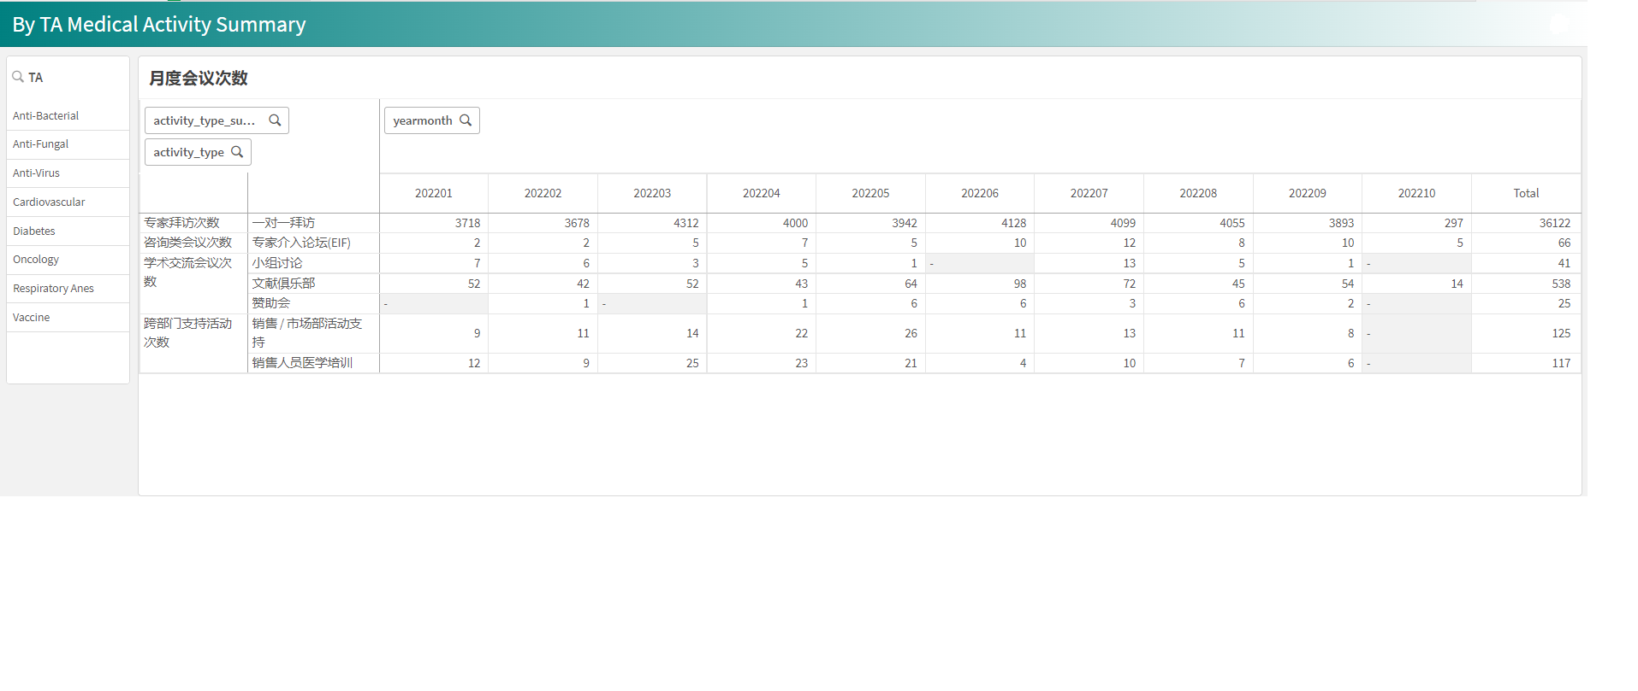
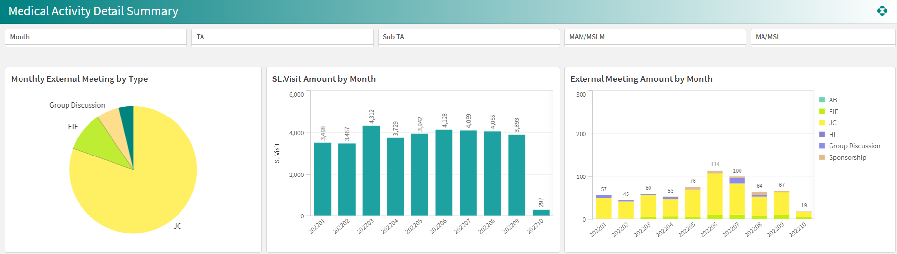
GMA China Medical Data and Report OntoHHIE
While field medical organize a local meeting, they will be required to record & request the meeting via SFDC eEvent system and following compliance, meeting service & finance process. And after meeting , field medical will also be required to record the similar info in SFDC medical CRM for reporting purpose. But most of information in eEvent are high overlap withing CRM .
Project Value
The project provides a managed data hosting for long-term GMA China data management and analytics.
Eliminate 5 days per month waiting for IT getting required data ready.
Save Field Medical approx.200 hours per year on entering meeting records in Medical CRM.
Save approx.160 hours per year IT/Business efforts on report adjustment per change/needs
Ensure GMA China data quality, improve overall reporting availability and increase business flexibility and user friendly
Objectives
Backend:
Optimize the flow of visit related data and eEvent PR related data to reduce the impact with Commercial data. Onboard enterprise WeChat data, automated enterprise WeChat related data stream
Frontend:
Implement reporting in Qlik Sense, including of three standard reports and four self-service reports, the business that is covered active data, inquiry data, content data and WeChat data.
Filed Medical value report
Filed Medical KPI Report
MIR Standard Report
Filed Medical Self-Service Report
MIR Self-Service Report
Content Activity Self-Service Report
YEYX Self-Service Report

